Slide 1
EMPLOYEE DATA ANALYSIS USING EXCEL
STUDENT NAME : JINUMOL.S.J
REGISTER NO : 312210912
DEPARTMENT : B.COM(GENERAL)
COLLEGE : BHAKTAVATSALAM MEMORIAL COLLEGE FOR WOMEN

Slide 2
PROJECT TITLE:
Employee Data Analysis Using Excel

Slide 3
AGENDA:
Problem Statement
Project Overview
End Users
Our SOLUTION And Proposition
Data Set Description
Modelling Approach
Results and Diuscussion
Conclusion

Slide 4
PROBLEM STATEMENT:
A Problem Statement is a description of an issue to be addressed. Or a condition to
Be improved upon . It identifies the gap between the current problem and goal . The first
Condition of solving a problem is understanding the problem , which can be done by way
Of a problem satatement.
Problem statement are used by most bussinesses and organisation to execute process
Improvement projects.

Slide 5
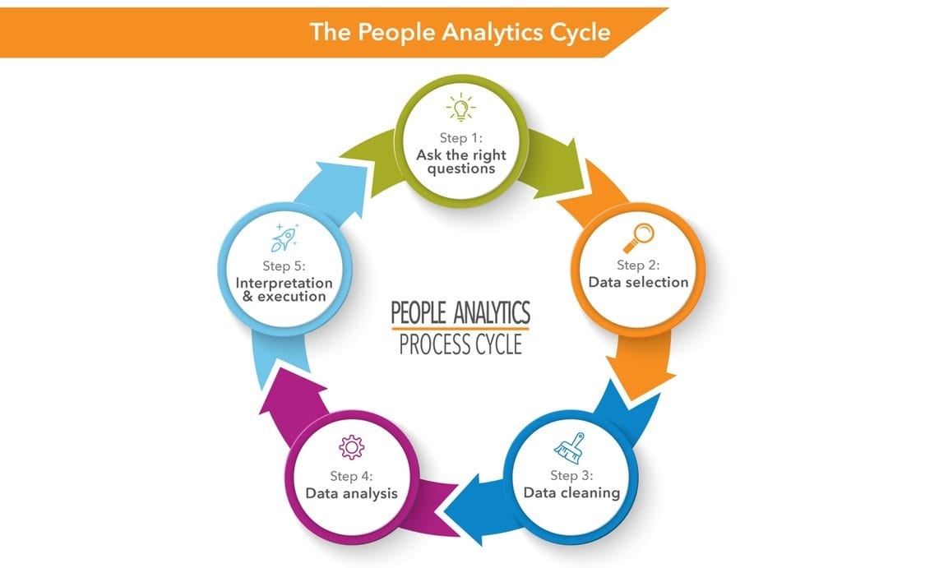
PROJECT OVERVIEW:

Slide 6
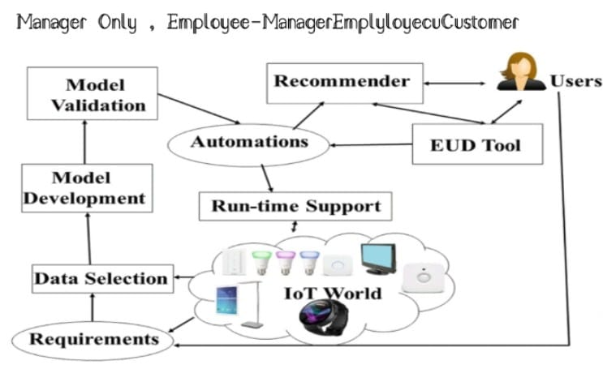
END USERS :

Slide 7
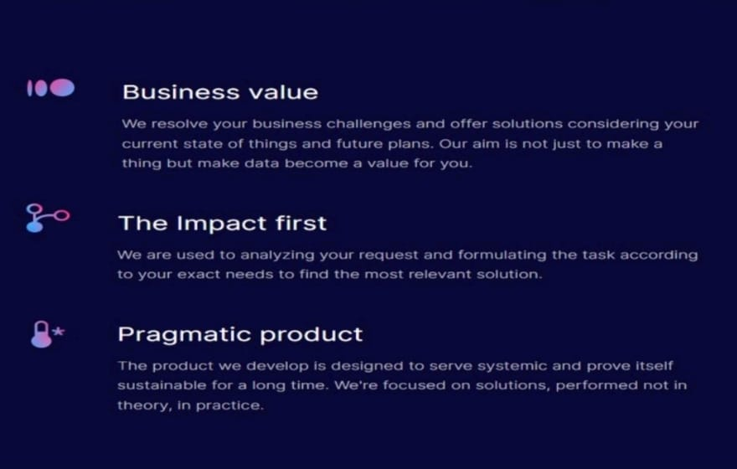
OUR SOLUTION AND PROPOSTION:

Slide 8
DATASET DESCRIPTION:
Name Gender DEPARTMENT SALARY
Jack Male Marketing 20,000
Isabella Female Training 39,000
William Male Support 42,000
Alex Male Service 52,000
Rose Female Business Development 15,000
Liam Male Marketing 25,000
Sophia Female Training 18,000
Anong Female Service 19,000

Slide 9
DATA SET DESCRIPTION:
A Data set is a collection of data . In the case of tabular data, a data set corresponds
To one or more database tables, where every column of a table represents a particulars
Variables , and each row corresponds to a given records of the data set in question.
A Data set is a collection of organized data that can be used for many purposes.

Slide 10
MODELLING APPROACH:
I get data from dashboard employee data analysis . And brief about the problem statement and project statement and project overview what to do and accurate information about the project overview . And end users are where it was started and where it was ended…our soloution and prospostion are solution the project . It is the profit motivate and satisfied the employee wants and needs.

Slide 11
RESULTS AND DISCUSSION:
ROW LABLES SUM OF SALARY COURT OF DEPARTMENT COURT OF EMPLOYEE TYPE
PR32284 25000 1 1
PR36989 55000 1 1
PR49265 45000 1 1
SQ04567 20000 1 1
SQ35789 19000 1 1
SQ58723 52000 1 1
SQ63874 46000 1 1
TN48576 61000 1 1
TN53798 39000 1 1
TN57698 15000 1 1
TN58379 60000 1 1
VT38456 18000 1 1
VT53848 53000 1 1
VT74859 42000 1 1
GRAND TOTAL : 550000 14 14

Slide 12
RESULTS:

Slide 13
CONCLUSION:
Now I conclude the presentation improve hiring and talent acquisition : Data analytics
Can help recruiters find professionals with the right skills and qualifications.
Employee strengths are important because they can affect performances, motivation, and
Retention. According to the strengths –based approach, fousing on and developing the
Strengths of your employees can lead to greater productivity and quality , higher
Engagement and satisfaction, and lower turnover and absenteeism.

